Slide 1
FIL-LAN

Slide 2

JAO
Error!
FIL_LAN
hej

Slide 3
FIL-LAN
Måndag 4 okt
08:00
09:00
10:00
11:00
12:00
13:00
14:00
15:00
16:00
17:00
18:00
19:00
20:00
21:00
22:00
23:00
Frukost
08:00
09:00
10:00
11:00
12:00
13:00
14:00
15:00
16:00
17:00
18:00
19:00
20:00
21:00
22:00
23:00
Frukost
Lunch
Lunch
Föreläsning
Föreläsning
FIFA Turnering
LOL Turnering
FIFA Turnering
LOL Turnering
M
T
O
T
F
L
Nyheter

Slide 4





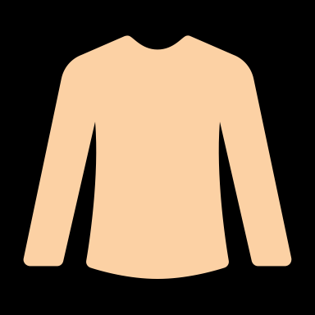
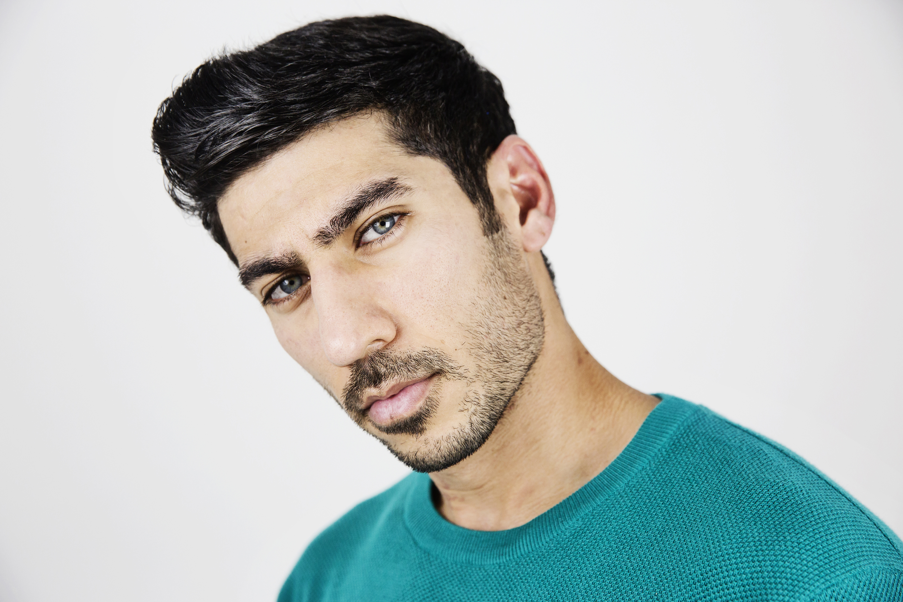


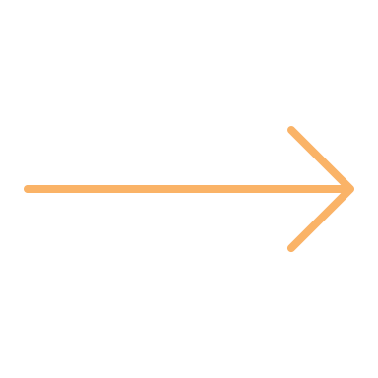


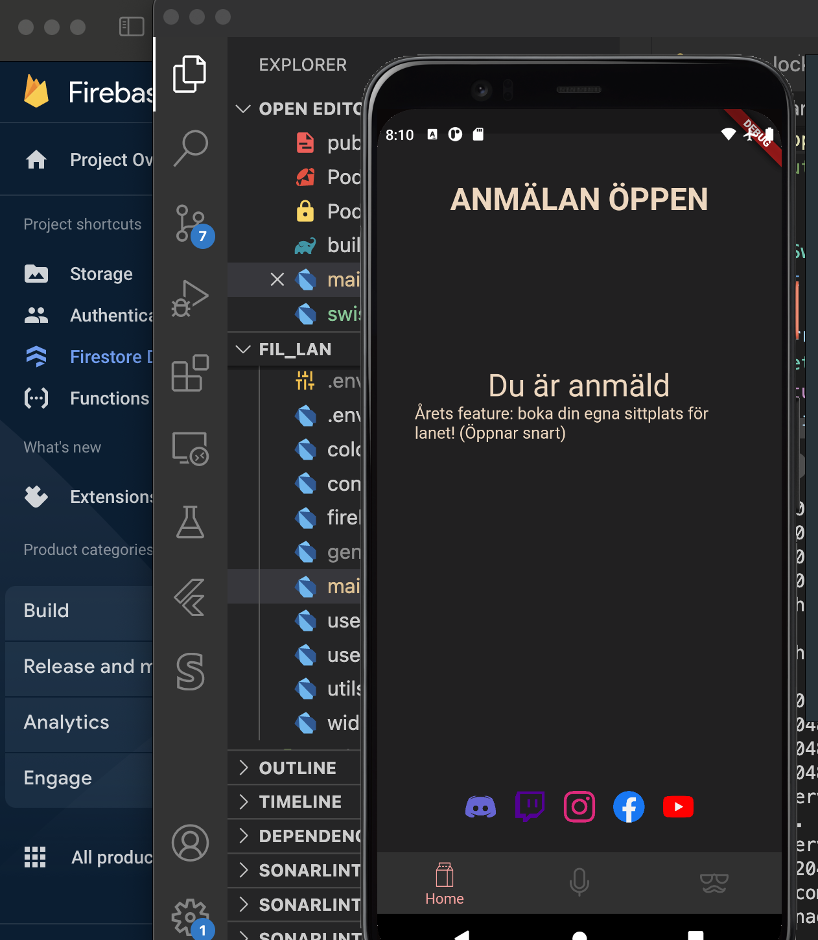
FIL-LAN
Måndag 4 okt
08:00
09:00
10:00
11:00
12:00
13:00
14:00
15:00
16:00
17:00
18:00
19:00
20:00
21:00
22:00
23:00
Frukost
08:00
09:00
10:00
11:00
12:00
13:00
14:00
15:00
16:00
17:00
18:00
19:00
20:00
21:00
22:00
23:00
Frukost
Lunch
Lunch
Föreläsning
Föreläsning
FIFA Turnering
LOL Turnering
FIFA Turnering
LOL Turnering
Nyheter
Resultatet från FIFA turneringen
Nu kan du beställa kläderna!
Beställ här
Turneringar
FIFA
5
LOL
8
WOW
4
5 OKT
7 OKT
11 OKT
Anmäl dig
Anmäl dig
Anmäl dig

Slide 5



Starlord
Status: ONLINE
Resultatet från FIFA turneringen
Nu kan du beställa kläderna!
Beställ här
Förnamn
Jose
FIFA
5
LOL
8
WOW
4
5 OKT
7 OKT
11 OKT
Efternamn
Anmäl dig
Anmäl dig
Anmäl dig
Roe
Email
Jose.roe@gmail.com
Telefon
01 234 567 89
Redigera konto

Slide 6
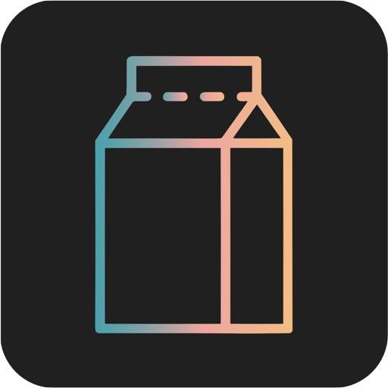
FIL-LAN
Måndag 4 okt
08:00
09:00
10:00
11:00
12:00
13:00
14:00
15:00
16:00
17:00
18:00
19:00
20:00
21:00
22:00
23:00
Frukost
08:00
09:00
10:00
11:00
12:00
13:00
14:00
15:00
16:00
17:00
18:00
19:00
20:00
21:00
22:00
23:00
Frukost
Lunch
Lunch
Föreläsning
Föreläsning
FIFA Turnering
LOL Turnering
FIFA Turnering
LOL Turnering
Nyheter
Logga in
Resultatet från FIFA turneringen
Nu kan du beställa kläderna!
Skapa konto
Beställ här
Turneringar
FIFA
5
LOL
8
WOW
4
5 OKT
7 OKT
11 OKT
Anmäl dig
Anmäl dig
Anmäl dig

Slide 7
Turneringar
Turneringar

Slide 8
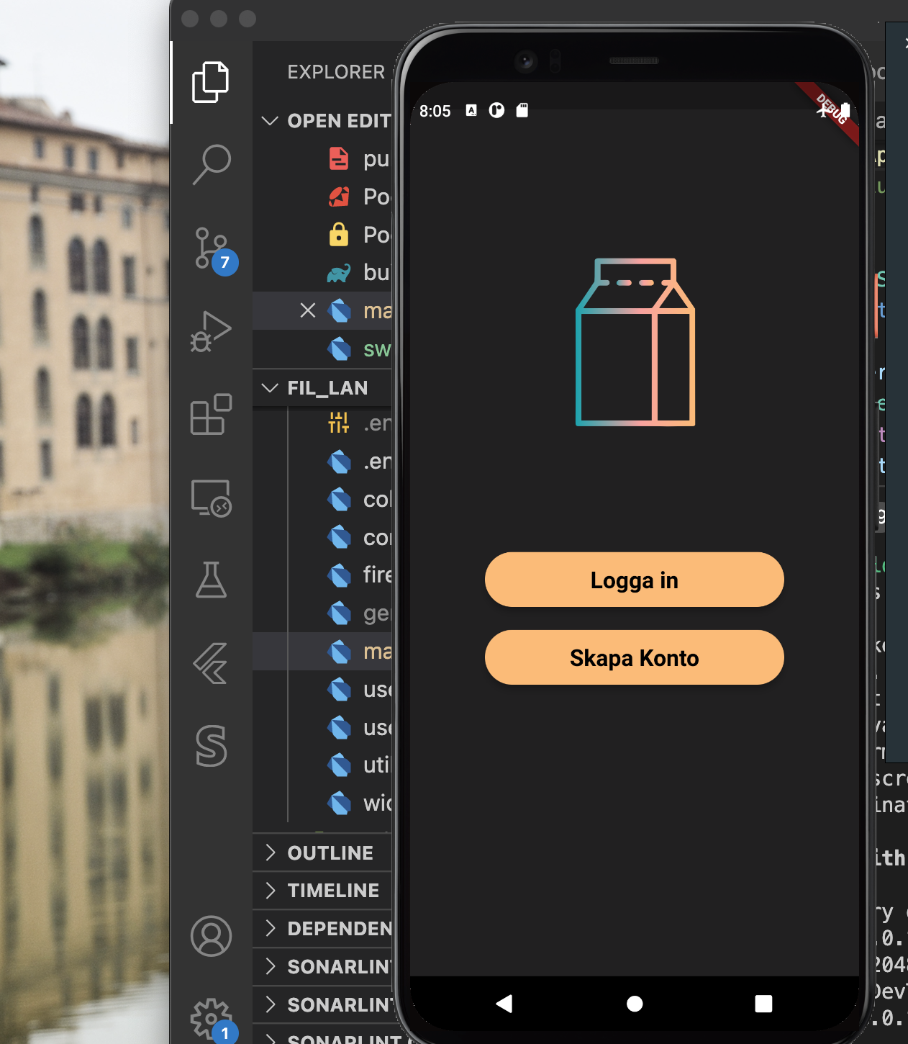
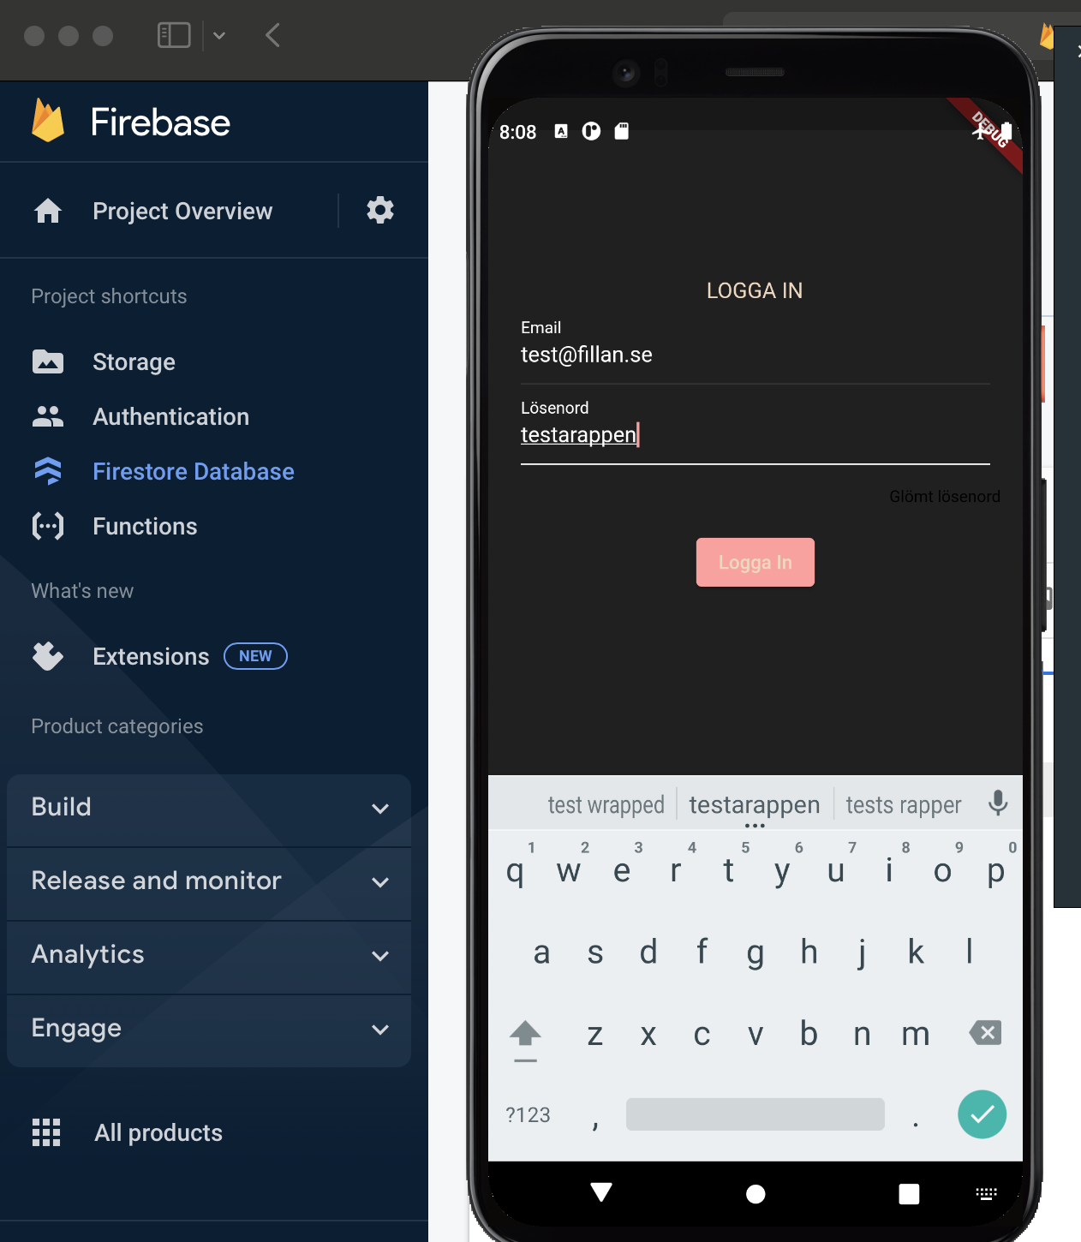
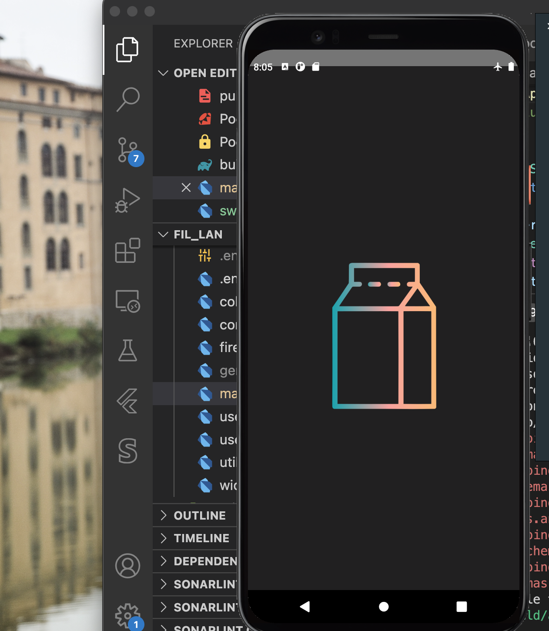
Email
exempel@mail.com
Lösenord
********
Logga in

Slide 10
main
opening
Authentication
widgets
Led-Menu
Del-Menu
Users
Ledare
Deltagare
studio
Profil
Fil- home
studio
Profil
Fil- home

Slide 11
import 'package:fil_lan/views/studio.dart';
import 'package:flutter/material.dart';
/// This is the stateful widget that the main application instantiates.
class Home extends StatefulWidget {
const Home({Key? key}) : super(key: key);
@override
State<Home> createState() => HomeState();
}
/// This is the private State class that goes with MyStatefulWidget.
class HomeState extends State<Home> {
static const TextStyle optionStyle =
TextStyle(fontSize: 30, fontWeight: FontWeight.bold);
@override
Widget build(BuildContext context) {
final mq = MediaQuery.of(context);
return Column(
mainAxisAlignment: MainAxisAlignment.start,
crossAxisAlignment: CrossAxisAlignment.stretch,
children: <Widget>[
Material(
elevation: 5.0,
borderRadius: BorderRadius.circular(25.0),
color: Colors.white,
child: MaterialButton(
minWidth: mq.size.width / 1.2,
padding: EdgeInsets.fromLTRB(10.0, 15.0, 10.0, 15.0),
child: Text(
"Logga in",
textAlign: TextAlign.center,
style: TextStyle(
fontSize: 20.0,
color: Colors.purple.shade900,
fontWeight: FontWeight.bold),
),
onPressed: () {},
),
),
Padding(
padding: EdgeInsets.fromLTRB(0, 15, 0, 70),
child: Material(
elevation: 5.0,
borderRadius: BorderRadius.circular(25.0),
color: Colors.white,
child: MaterialButton(
minWidth: mq.size.width / 1.2,
padding: EdgeInsets.fromLTRB(10.0, 15.0, 10.0, 15.0),
child: Text(
"Skapa Konto",
textAlign: TextAlign.center,
style: TextStyle(
fontSize: 20.0,
color: Colors.purple.shade900,
fontWeight: FontWeight.bold),
),
onPressed: () {},
),
),
),
],
);
}
}
import 'package:fil_lan/routes.dart';
import 'package:fil_lan/views/start_screen.dart';
import 'package:flutter/material.dart';
import 'package:flutter/widgets.dart';
class Login extends StatefulWidget {
@override
_LoginSate createState() => _LoginSate();
}
class _LoginSate extends State<Login> {
final _formkey = GlobalKey<FormState>();
final _emailController = TextEditingController();
final _passwordController = TextEditingController();
//bool isSubmitting = false;
@override
Widget build(BuildContext context) {
final mq = MediaQuery.of(context);
final logo = Image.asset(
"assets/milk-box.png",
height: mq.size.height / 4,
);
final emailField = TextFormField(
//enabled: isSubmitting,
controller: _emailController,
keyboardType: TextInputType.emailAddress,
style:
const TextStyle(color: Colors.white, decorationColor: Colors.white),
cursorColor: Colors.white,
decoration: const InputDecoration(
focusColor: Colors.white,
hintText: "something@example.com",
hintStyle: TextStyle(color: Colors.white),
labelText: "Email"),
);
final passwordField = Column(
children: [
TextFormField(
//enabled: isSubmitting,
controller: _passwordController,
style: const TextStyle(color: Colors.white),
decoration: const InputDecoration(
hintText: "password",
hintStyle: TextStyle(color: Colors.white),
labelText: "Password"),
),
const Padding(
padding: EdgeInsets.all(2.0),
),
Row(
children: [
MaterialButton(
onPressed: () {},
child: Text(
"Glömt Lösenord",
style: Theme.of(context)
.textTheme
.caption
?.copyWith(color: Colors.white),
),
),
],
)
],
);
final loginbutton = Material(
elevation: 5.0,
borderRadius: BorderRadius.circular(25.0),
color: Colors.white,
child: MaterialButton(
minWidth: mq.size.width / 1.2,
padding: const EdgeInsets.fromLTRB(10.0, 15.0, 10.0, 15.0),
child: Text(
"Logga in",
textAlign: TextAlign.center,
style: TextStyle(
fontSize: 20.0,
color: Colors.purple.shade900,
fontWeight: FontWeight.bold),
),
onPressed: () {
//todo
},
),
);
final fields = Padding(
padding: EdgeInsets.all(0),
child: Column(
mainAxisAlignment: MainAxisAlignment.spaceBetween,
children: <Widget>[emailField, passwordField, loginbutton],
),
);
final bottom = Column(
mainAxisAlignment: MainAxisAlignment.start,
crossAxisAlignment: CrossAxisAlignment.stretch,
children: <Widget>[
const Padding(padding: EdgeInsets.all(8.0)),
Row(
mainAxisAlignment: MainAxisAlignment.spaceBetween,
children: [
Text(
"Inte registrerad?",
style: Theme.of(context).textTheme.subtitle1?.copyWith(
color: Colors.white,
),
),
MaterialButton(
onPressed: () {
Navigator.of(context).pushNamed(AppRouter.authRegister);
},
child: Text(
"Skapa Konto",
style: Theme.of(context).textTheme.subtitle1?.copyWith(
color: Colors.white, decoration: TextDecoration.underline),
),
)
],
)
],
);
return Scaffold(
backgroundColor: Colors.amber,
body: Form(
key: _formkey,
child: SingleChildScrollView(
padding: const EdgeInsets.all(36),
child: Column(
mainAxisAlignment: MainAxisAlignment.spaceAround,
children: <Widget>[logo, fields, bottom],
),
),
),
);
}
}
import 'package:fil_lan/routes.dart';
import 'package:fil_lan/views/start_screen.dart';
import 'package:flutter/material.dart';
import 'package:flutter/widgets.dart';
import 'package:firebase_core/firebase_core.dart'; // new
import 'package:firebase_auth/firebase_auth.dart';
import 'package:provider/provider.dart';
class Register extends StatefulWidget {
@override
_RegisterSate createState() => _RegisterSate();
}
class _RegisterSate extends State<Register> {
final _formkey = GlobalKey<FormState>();
final _usernameController = TextEditingController();
final _emailController = TextEditingController();
final _passwordController = TextEditingController();
final _ageController = TextEditingController();
//bool isSubmitting = false;
@override
Widget build(BuildContext context) {
final mq = MediaQuery.of(context);
final logo = Image.asset(
"assets/milk-box.png",
height: mq.size.height / 4,
);
final usernameField = TextFormField(
//enabled: isSubmitting,
controller: _usernameController,
style:
const TextStyle(color: Colors.white, decorationColor: Colors.white),
cursorColor: Colors.white,
decoration: const InputDecoration(
focusedBorder: UnderlineInputBorder(
borderSide: BorderSide(color: Colors.white),
),
focusColor: Colors.white,
hintText: "Förnamn",
hintStyle: TextStyle(color: Colors.white),
labelText: "Namn",
labelStyle: TextStyle(color: Colors.white),
),
);
final emailField = TextFormField(
//enabled: isSubmitting,
controller: _emailController,
keyboardType: TextInputType.emailAddress,
style:
const TextStyle(color: Colors.white, decorationColor: Colors.white),
cursorColor: Colors.white,
decoration: const InputDecoration(
focusedBorder: UnderlineInputBorder(
borderSide: BorderSide(color: Colors.white),
),
focusColor: Colors.white,
hintText: "something@example.com",
hintStyle: TextStyle(color: Colors.white),
labelText: "Email",
labelStyle: TextStyle(color: Colors.white),
),
);
final passwordField = TextFormField(
//enabled: isSubmitting,
controller: _passwordController,
style: const TextStyle(color: Colors.white),
cursorColor: Colors.white,
decoration: const InputDecoration(
focusedBorder: UnderlineInputBorder(
borderSide: BorderSide(color: Colors.white),
),
hintText: "password",
hintStyle: TextStyle(color: Colors.white),
labelText: "Password",
labelStyle: TextStyle(color: Colors.white),
),
);
final ageField = TextFormField(
//enabled: isSubmitting,
controller: _ageController,
style:
const TextStyle(color: Colors.white, decorationColor: Colors.white),
cursorColor: Colors.white,
decoration: const InputDecoration(
focusedBorder: UnderlineInputBorder(
borderSide: BorderSide(color: Colors.white),
),
focusColor: Colors.white,
hintText: "ÅÅÅÅ-MM-DD-XXXX",
hintStyle: TextStyle(color: Colors.white),
labelText: "Personnummer",
labelStyle: TextStyle(color: Colors.white),
),
);
final loginbutton = Material(
elevation: 5.0,
borderRadius: BorderRadius.circular(25.0),
color: Colors.white,
child: MaterialButton(
minWidth: mq.size.width / 1.2,
padding: const EdgeInsets.fromLTRB(10.0, 15.0, 10.0, 15.0),
child: Text(
"Registrera",
textAlign: TextAlign.center,
style: TextStyle(
fontSize: 20.0,
color: Colors.purple.shade900,
fontWeight: FontWeight.bold),
),
onPressed: () {},
//todo
),
);
final fields = Padding(
padding: EdgeInsets.all(15),
child: Column(
mainAxisAlignment: MainAxisAlignment.spaceBetween,
children: <Widget>[
usernameField,
emailField,
passwordField,
ageField,
],
),
);
final bottom = Column(
mainAxisAlignment: MainAxisAlignment.start,
crossAxisAlignment: CrossAxisAlignment.stretch,
children: <Widget>[
const Padding(padding: EdgeInsets.all(8.0)),
Row(
mainAxisAlignment: MainAxisAlignment.spaceBetween,
children: [
Text(
"Har du redan ett konto?",
style: Theme.of(context).textTheme.subtitle1?.copyWith(
color: Colors.white,
),
),
MaterialButton(
onPressed: () {
Navigator.of(context).pushNamed(AppRouter.authLogin);
},
child: Text(
"Logga in",
style: Theme.of(context).textTheme.subtitle1?.copyWith(
color: Colors.white, decoration: TextDecoration.underline),
),
)
],
)
],
);
return Scaffold(
backgroundColor: Colors.amber,
body: Form(
key: _formkey,
child: SingleChildScrollView(
padding: const EdgeInsets.all(36),
child: Column(
mainAxisAlignment: MainAxisAlignment.spaceAround,
children: <Widget>[logo, fields, loginbutton, bottom],
),
),
),
);
}
}
import 'package:fil_lan/routes.dart';
import 'package:fil_lan/views/login_screen.dart';
import 'package:flutter/material.dart';
class StartScreen extends StatelessWidget {
@override
Widget build(BuildContext context) {
final mq = MediaQuery.of(context);
final logo = Image.asset(
"assets/milk-box.png",
height: mq.size.height / 4,
);
final loginButton = Material(
elevation: 5.0,
borderRadius: BorderRadius.circular(25.0),
color: Colors.white,
child: MaterialButton(
minWidth: mq.size.width / 1.2,
padding: EdgeInsets.fromLTRB(10.0, 15.0, 10.0, 15.0),
child: Text(
"Logga in",
textAlign: TextAlign.center,
style: TextStyle(
fontSize: 20.0,
color: Colors.purple.shade900,
fontWeight: FontWeight.bold),
),
onPressed: () {
Navigator.of(context).pushNamed(AppRouter.authLogin);
},
),
);
final registerButton = Material(
elevation: 5.0,
borderRadius: BorderRadius.circular(25.0),
color: Colors.white,
child: MaterialButton(
minWidth: mq.size.width / 1.2,
padding: EdgeInsets.fromLTRB(10.0, 15.0, 10.0, 15.0),
child: Text(
"Skapa Konto",
textAlign: TextAlign.center,
style: TextStyle(
fontSize: 20.0,
color: Colors.purple.shade900,
fontWeight: FontWeight.bold),
),
onPressed: () {
Navigator.of(context).pushNamed(AppRouter.authRegister);
},
),
);
final buttons = Column(
mainAxisAlignment: MainAxisAlignment.start,
crossAxisAlignment: CrossAxisAlignment.stretch,
children: <Widget>[
loginButton,
Padding(
padding: EdgeInsets.fromLTRB(0, 15, 0, 70),
child: registerButton,
),
],
);
return Scaffold(
backgroundColor: Color(0xff8c52ff),
body: Padding(
padding: EdgeInsets.all(36),
child: Column(
mainAxisAlignment: MainAxisAlignment.spaceBetween,
children: <Widget>[
Padding(
padding: EdgeInsets.only(top: 50),
child: logo,
),
buttons,
],
),
),
);
}
}
import 'package:fil_lan/main.dart';
import 'package:fil_lan/views/home.dart';
import 'package:flutter/material.dart';
import 'widgets.dart';
enum ApplicationLoginState {
loggedOut,
emailAddress,
register,
password,
loggedIn,
}
class Authentication extends StatelessWidget {
const Authentication({
required this.loginState,
required this.email,
required this.startLoginFlow,
required this.verifyEmail,
required this.signInWithEmailAndPassword,
required this.cancelRegistration,
required this.registerAccount,
required this.signOut,
});
final ApplicationLoginState loginState;
final String? email;
final void Function() startLoginFlow;
final void Function(
String email,
void Function(Exception e) error,
) verifyEmail;
final void Function(
String email,
String password,
void Function(Exception e) error,
) signInWithEmailAndPassword;
final void Function() cancelRegistration;
final void Function(
String email,
String displayName,
String password,
void Function(Exception e) error,
) registerAccount;
final void Function() signOut;
@override
Widget build(BuildContext context) {
final mq = MediaQuery.of(context);
switch (loginState) {
case ApplicationLoginState.loggedOut:
return Column(
mainAxisAlignment: MainAxisAlignment.start,
crossAxisAlignment: CrossAxisAlignment.stretch,
children: <Widget>[
Material(
elevation: 5.0,
borderRadius: BorderRadius.circular(25.0),
color: Colors.white,
child: MaterialButton(
minWidth: mq.size.width / 1.2,
padding: EdgeInsets.fromLTRB(10.0, 15.0, 10.0, 15.0),
child: Text(
"Logga in",
textAlign: TextAlign.center,
style: TextStyle(
fontSize: 20.0,
color: Colors.purple.shade900,
fontWeight: FontWeight.bold),
),
onPressed: () {
startLoginFlow();
},
),
),
Padding(
padding: EdgeInsets.fromLTRB(0, 15, 0, 70),
child: Material(
elevation: 5.0,
borderRadius: BorderRadius.circular(25.0),
color: Colors.white,
child: MaterialButton(
minWidth: mq.size.width / 1.2,
padding: EdgeInsets.fromLTRB(10.0, 15.0, 10.0, 15.0),
child: Text(
"Skapa Konto",
textAlign: TextAlign.center,
style: TextStyle(
fontSize: 20.0,
color: Colors.purple.shade900,
fontWeight: FontWeight.bold),
),
onPressed: () {
startLoginFlow();
},
),
),
),
],
);
case ApplicationLoginState.emailAddress:
return EmailForm(
callback: (email) => verifyEmail(
email, (e) => _showErrorDialog(context, 'Invalid email', e)));
case ApplicationLoginState.password:
return PasswordForm(
email: email!,
login: (email, password) {
signInWithEmailAndPassword(email, password,
(e) => _showErrorDialog(context, 'Failed to sign in', e));
},
);
case ApplicationLoginState.register:
return RegisterForm(
email: email!,
cancel: () {
cancelRegistration();
},
registerAccount: (
email,
displayName,
password,
) {
registerAccount(
email,
displayName,
password,
(e) =>
_showErrorDialog(context, 'Failed to create account', e));
},
);
case ApplicationLoginState.loggedIn:
return ElevatedButton(
onPressed: () {
signOut();
},
child: Text("logga ut"));
default:
return Row(
children: const [
Text("Internal error, this shouldn't happen..."),
],
);
}
}
void _showErrorDialog(BuildContext context, String title, Exception e) {
showDialog<void>(
context: context,
builder: (context) {
return AlertDialog(
title: Text(
title,
style: const TextStyle(fontSize: 24),
),
content: SingleChildScrollView(
child: ListBody(
children: <Widget>[
Text(
'${(e as dynamic).message}',
style: const TextStyle(fontSize: 18),
),
],
),
),
actions: <Widget>[
StyledButton(
onPressed: () {
Navigator.of(context).pop();
},
child: const Text(
'OK',
style: TextStyle(color: Colors.deepPurple),
),
),
],
);
},
);
}
}
class EmailForm extends StatefulWidget {
const EmailForm({required this.callback});
final void Function(String email) callback;
@override
_EmailFormState createState() => _EmailFormState();
}
class _EmailFormState extends State<EmailForm> {
final _formKey = GlobalKey<FormState>(debugLabel: '_EmailFormState');
final _controller = TextEditingController();
@override
Widget build(BuildContext context) {
return Column(
children: [
const Header('Sign in with email'),
Padding(
padding: const EdgeInsets.all(8.0),
child: Form(
key: _formKey,
child: Column(
crossAxisAlignment: CrossAxisAlignment.start,
children: <Widget>[
Padding(
padding: const EdgeInsets.symmetric(horizontal: 24),
child: TextFormField(
controller: _controller,
keyboardType: TextInputType.emailAddress,
style: const TextStyle(
color: Colors.white, decorationColor: Colors.white),
cursorColor: Colors.white,
decoration: const InputDecoration(
focusColor: Colors.white,
hintText: "something@example.com",
hintStyle: TextStyle(color: Colors.white),
labelText: "Email"),
validator: (value) {
if (value!.isEmpty) {
return 'Enter your email address to continue';
}
return null;
},
),
),
Row(
mainAxisAlignment: MainAxisAlignment.end,
children: [
Padding(
padding: const EdgeInsets.symmetric(
vertical: 16.0, horizontal: 30),
child: ElevatedButton(
onPressed: () async {
if (_formKey.currentState!.validate()) {
widget.callback(_controller.text);
}
},
child: const Text('NEXT'),
),
),
],
),
],
),
),
),
],
);
}
}
class RegisterForm extends StatefulWidget {
const RegisterForm({
required this.registerAccount,
required this.cancel,
required this.email,
});
final String email;
final void Function(String email, String displayName, String password)
registerAccount;
final void Function() cancel;
@override
_RegisterFormState createState() => _RegisterFormState();
}
class _RegisterFormState extends State<RegisterForm> {
final _formKey = GlobalKey<FormState>(debugLabel: '_RegisterFormState');
final _emailController = TextEditingController();
final _displayNameController = TextEditingController();
final _passwordController = TextEditingController();
@override
void initState() {
super.initState();
_emailController.text = widget.email;
}
@override
Widget build(BuildContext context) {
return Column(
children: [
const Header('Create account'),
Padding(
padding: const EdgeInsets.all(8.0),
child: Form(
key: _formKey,
child: Column(
crossAxisAlignment: CrossAxisAlignment.start,
children: <Widget>[
Padding(
padding: const EdgeInsets.symmetric(horizontal: 24),
child: TextFormField(
controller: _emailController,
keyboardType: TextInputType.emailAddress,
style: const TextStyle(
color: Colors.white, decorationColor: Colors.white),
cursorColor: Colors.white,
decoration: const InputDecoration(
focusColor: Colors.white,
hintText: "something@example.com",
hintStyle: TextStyle(color: Colors.white),
labelText: "Email"),
validator: (value) {
if (value!.isEmpty) {
return 'Enter your email address to continue';
}
return null;
},
),
),
Padding(
padding: const EdgeInsets.symmetric(horizontal: 24),
child: TextFormField(
controller: _displayNameController,
keyboardType: TextInputType.emailAddress,
style: const TextStyle(
color: Colors.white, decorationColor: Colors.white),
cursorColor: Colors.white,
decoration: const InputDecoration(
focusColor: Colors.white,
hintText: "username",
hintStyle: TextStyle(color: Colors.white),
labelText: "Username"),
validator: (value) {
if (value!.isEmpty) {
return 'Enter your account name';
}
return null;
},
),
),
Padding(
padding: const EdgeInsets.symmetric(horizontal: 24),
child: TextFormField(
controller: _passwordController,
keyboardType: TextInputType.emailAddress,
style: const TextStyle(
color: Colors.white, decorationColor: Colors.white),
cursorColor: Colors.white,
decoration: const InputDecoration(
focusColor: Colors.white,
hintText: "password",
hintStyle: TextStyle(color: Colors.white),
labelText: "Password"),
obscureText: true,
validator: (value) {
if (value!.isEmpty) {
return 'Enter your password';
}
return null;
},
),
),
Padding(
padding: const EdgeInsets.symmetric(vertical: 16),
child: Row(
mainAxisAlignment: MainAxisAlignment.end,
children: [
TextButton(
onPressed: widget.cancel,
child: const Text('CANCEL'),
),
const SizedBox(width: 16),
StyledButton(
onPressed: () {
if (_formKey.currentState!.validate()) {
widget.registerAccount(
_emailController.text,
_displayNameController.text,
_passwordController.text,
);
}
},
child: const Text('SAVE'),
),
const SizedBox(width: 30),
],
),
),
],
),
),
),
],
);
}
}
class PasswordForm extends StatefulWidget {
const PasswordForm({
required this.login,
required this.email,
});
final String email;
final void Function(String email, String password) login;
@override
_PasswordFormState createState() => _PasswordFormState();
}
class _PasswordFormState extends State<PasswordForm> {
final _formKey = GlobalKey<FormState>(debugLabel: '_PasswordFormState');
final _emailController = TextEditingController();
final _passwordController = TextEditingController();
@override
void initState() {
super.initState();
_emailController.text = widget.email;
}
@override
Widget build(BuildContext context) {
return Column(
children: [
const Header('Sign in'),
Padding(
padding: const EdgeInsets.all(8.0),
child: Form(
key: _formKey,
child: Column(
crossAxisAlignment: CrossAxisAlignment.start,
children: <Widget>[
Padding(
padding: const EdgeInsets.symmetric(horizontal: 24),
child: TextFormField(
controller: _emailController,
keyboardType: TextInputType.emailAddress,
style: const TextStyle(
color: Colors.white, decorationColor: Colors.white),
cursorColor: Colors.white,
decoration: const InputDecoration(
focusColor: Colors.white,
hintText: "something@example.com",
hintStyle: TextStyle(color: Colors.white),
labelText: "Email"),
validator: (value) {
if (value!.isEmpty) {
return 'Enter your email address to continue';
}
return null;
},
),
),
Padding(
padding: const EdgeInsets.symmetric(horizontal: 24),
child: TextFormField(
controller: _passwordController,
keyboardType: TextInputType.emailAddress,
style: const TextStyle(
color: Colors.white, decorationColor: Colors.white),
cursorColor: Colors.white,
decoration: const InputDecoration(
focusColor: Colors.white,
hintText: "password",
hintStyle: TextStyle(color: Colors.white),
labelText: "Password"),
obscureText: true,
validator: (value) {
if (value!.isEmpty) {
return 'Enter your password';
}
return null;
},
),
),
Padding(
padding: const EdgeInsets.symmetric(vertical: 16),
child: Row(
mainAxisAlignment: MainAxisAlignment.end,
children: [
const SizedBox(width: 16),
StyledButton(
onPressed: () {
if (_formKey.currentState!.validate()) {
widget.login(
_emailController.text,
_passwordController.text,
);
}
},
child: const Text('SIGN IN'),
),
const SizedBox(width: 30),
],
),
),
],
),
),
),
],
);
}
}
import 'package:fil_lan/root.dart';
import 'package:fil_lan/routes.dart';
import 'package:fil_lan/views/studio.dart';
import 'package:firebase_core/firebase_core.dart'; // new
import 'package:firebase_auth/firebase_auth.dart'; // new
import 'package:flutter/material.dart';
import 'package:provider/provider.dart'; // new
import 'views/start_screen.dart';
import 'src/authentication.dart'; // new
import 'src/widgets.dart';
import 'views/home.dart';
void main() {
runApp(
ChangeNotifierProvider(
create: (context) => ApplicationState(),
builder: (context, _) => MyApp(),
),
);
}
class MyApp extends StatelessWidget {
@override
Widget build(BuildContext context) {
return MaterialApp(
title: "FIL-LAN",
theme: ThemeData(primarySwatch: Colors.purple),
home: RootPage(),
);
}
}
class Start extends StatefulWidget {
const Start({Key? key}) : super(key: key);
@override
State<StatefulWidget> createState() {
// TODO: implement createState
return StartState();
}
}
class StartState extends State<Start> {
int currentIndex = 0;
final screens = [
Home(),
Studio(),
];
@override
Widget build(BuildContext context) {
// TODO: implement build
return Scaffold(
backgroundColor: const Color(0xff8c52ff),
body: IndexedStack(
children: screens,
index: currentIndex,
),
bottomNavigationBar: BottomNavigationBar(
backgroundColor: const Color(0xff8c52ff),
items: const <BottomNavigationBarItem>[
BottomNavigationBarItem(
icon: Icon(Icons.home),
label: 'FILLAN',
backgroundColor: Colors.red,
),
BottomNavigationBarItem(
icon: Icon(Icons.business),
label: 'STUDIO',
backgroundColor: Colors.green,
),
BottomNavigationBarItem(
icon: Icon(Icons.account_circle),
label: 'PROFIL',
backgroundColor: Colors.purple,
),
],
currentIndex: currentIndex,
unselectedItemColor: Colors.purple.shade600,
selectedItemColor: Colors.purple.shade100,
onTap: (index) => setState(
() => currentIndex = index,
),
),
);
}
}
class HomePage extends StatelessWidget {
const HomePage({Key? key}) : super(key: key);
@override
Widget build(BuildContext context) {
final mq = MediaQuery.of(context);
return Scaffold(
backgroundColor: Color(0xff8c52ff),
body: Padding(
padding: EdgeInsets.all(36),
child: Column(
children: <Widget>[
Padding(
padding: EdgeInsets.only(top: 50),
child: Image.asset(
"assets/milk-box.png",
height: mq.size.height / 4,
),
),
Consumer<ApplicationState>(
builder: (context, appState, _) => Authentication(
email: appState.email,
loginState: appState.loginState,
startLoginFlow: appState.startLoginFlow,
verifyEmail: appState.verifyEmail,
signInWithEmailAndPassword: appState.signInWithEmailAndPassword,
cancelRegistration: appState.cancelRegistration,
registerAccount: appState.registerAccount,
signOut: appState.signOut,
),
),
],
),
),
);
}
}
class ApplicationState extends ChangeNotifier {
ApplicationState() {
init();
}
Future<void> init() async {
await Firebase.initializeApp();
FirebaseAuth.instance.userChanges().listen((user) {
if (user != null) {
_loginState = ApplicationLoginState.loggedIn;
} else {
_loginState = ApplicationLoginState.loggedOut;
}
notifyListeners();
});
}
ApplicationLoginState _loginState = ApplicationLoginState.loggedOut;
ApplicationLoginState get loginState => _loginState;
String? _email;
String? get email => _email;
void startLoginFlow() {
_loginState = ApplicationLoginState.emailAddress;
notifyListeners();
}
void verifyEmail(
String email,
void Function(FirebaseAuthException e) errorCallback,
) async {
try {
var methods =
await FirebaseAuth.instance.fetchSignInMethodsForEmail(email);
if (methods.contains('password')) {
_loginState = ApplicationLoginState.password;
} else {
_loginState = ApplicationLoginState.register;
}
_email = email;
notifyListeners();
} on FirebaseAuthException catch (e) {
errorCallback(e);
}
}
void signInWithEmailAndPassword(
String email,
String password,
void Function(FirebaseAuthException e) errorCallback,
) async {
try {
await FirebaseAuth.instance.signInWithEmailAndPassword(
email: email,
password: password,
);
} on FirebaseAuthException catch (e) {
errorCallback(e);
}
}
void cancelRegistration() {
_loginState = ApplicationLoginState.emailAddress;
notifyListeners();
}
void registerAccount(String email, String displayName, String password,
void Function(FirebaseAuthException e) errorCallback) async {
try {
var credential = await FirebaseAuth.instance
.createUserWithEmailAndPassword(email: email, password: password);
await credential.user!.updateDisplayName(displayName);
} on FirebaseAuthException catch (e) {
errorCallback(e);
}
}
void botnavbar() {
if (_loginState == ApplicationLoginState.loggedIn) {
} else {}
}
void signOut() {
FirebaseAuth.instance.signOut();
}
}

